Slide 1

MULUNGUSHI UNIVERSITY
School of Engineering and Technology
ICT411 Cloud Computing
Unit 1: Foundations & Context
Lecture 1
Lecturer: Mr. M Bwalya
Notes:
Introduce cloud computing as a practical design topic. Students should leave the unit able to discuss cloud adoption with technical and business reasoning.

Slide 2


LECTURE 1
Learning outcomes for this lecture
• Define cloud computing using service delivery, internet access, and on-demand resource concepts.
• Describe the five essential cloud characteristics using realistic examples.
• Analyze benefits, challenges, legal issues, and vulnerabilities before recommending a cloud solution.
• Interpret a basic cloud architecture and identify the main NIST cloud actors.
ICT411 Cloud Computing • Unit 1 • Foundations & Context
2
Notes:
Emphasize that students will not only memorize definitions; they must explain, compare, evaluate, and justify decisions.

Slide 3
LECTURE 1
Lecture roadmap: how the unit is organised
1
Context and evolution
2
Definition and characteristics
3
Benefits and challenges
4
Architecture and actors
5
Lab and summary
• First we build a clear mental model of what cloud computing means.
• Then we connect the model to reliability, scalability, security, cost, and policy decisions.
• The unit ends with a practical adoption mini-assessment that prepares students for later hands-on labs.
ICT411 Cloud Computing • Unit 1 • Foundations & Context
3
Notes:
Use this slide to set expectations and keep students oriented throughout the lecture.

Slide 4
LECTURE 1
Why cloud computing matters
Cloud computing is now a normal way of building, deploying, securing, and scaling software systems.
• Software engineers deploy applications without waiting for physical servers to be purchased and installed.
• Systems can start small and grow as more users join, which is useful for start-ups, universities, banks, hospitals, and government systems.
• Cloud changes how we think about infrastructure: servers, storage, networking, identity, monitoring, and cost become programmable services.
• Modern computer scientists must understand both code and the platform on which that code runs.
Industry mindset: build for growth, failure, security, cost, and user experience from day one.
ICT411 Cloud Computing • Unit 1 • Foundations & Context
4
Notes:
Relate this to student portals, e-learning systems, mobile apps, online banking, and public service platforms.

Slide 5
LECTURE 1
The traditional IT problem
• In traditional environments, an organisation buys servers, storage, network equipment, licences, backup devices, and cooling before the system is fully used.
• Capacity planning is difficult because user demand may rise suddenly during registration, payments, results publication, or national events.
• Too little capacity causes slow systems and service failure; too much capacity wastes money and electricity.
• Manual setup slows down innovation because developers may wait days or weeks before testing a new system.
Capacity mismatch
Too little capacity
→ slow or failed service
Too much capacity
→ wasted budget
Cloud goal
→ match resources to demand
ICT411 Cloud Computing • Unit 1 • Foundations & Context
5
Notes:
Ask students to identify systems that become overloaded at predictable peak periods.

Slide 6
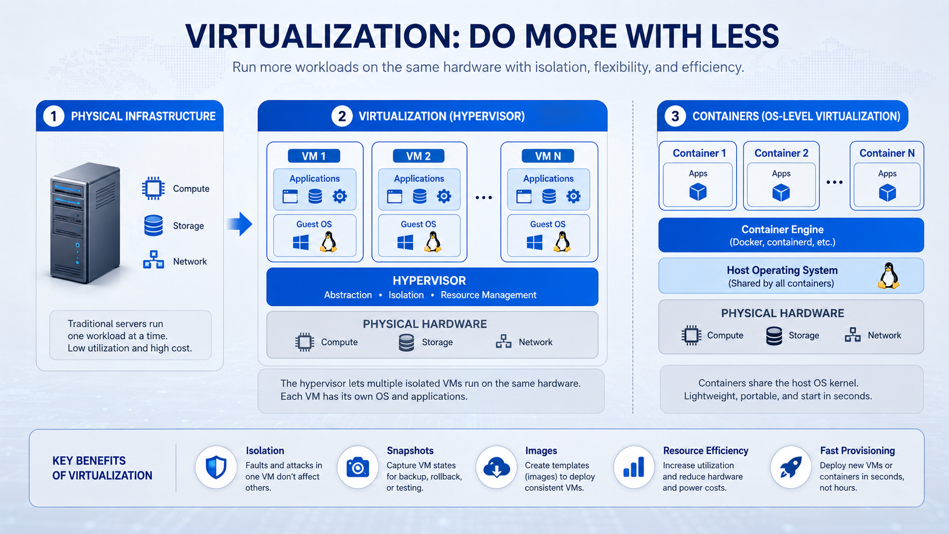
LECTURE 1
Technology enablers that made cloud possible
• Virtualization allows one physical server to safely run many isolated virtual machines or environments.
• Fast internet and standard web protocols allow remote access from many devices and locations.
• Automation tools make it possible to create, monitor, scale, and remove resources quickly.
• Large data centers pool compute, storage, network, cooling, power, and physical security.
• APIs expose infrastructure capabilities to developers and operations teams.
Cloud is not one technology. It combines virtualization, networking, automation, data centers, APIs, and service delivery.
ICT411 Cloud Computing • Unit 1 • Foundations & Context
9
Notes:
Use the diagram to show how virtualization improves hardware utilisation and isolation. Then connect virtualization to automation, networking, APIs, and data-center scale.

Slide 7
LECTURE 1
Working definition of cloud computing
Cloud computing is the delivery of computing services over the internet, including storage, processing power, networking, and software applications.
• Users access resources when needed instead of owning and maintaining every physical server locally.
• Providers operate data centers and expose services through portals, dashboards, command-line tools, and APIs.
• Consumers usually pay based on subscription, allocation, or actual measured usage.
• The definition includes both technology and the service model used to deliver that technology.
ICT411 Cloud Computing • Unit 1 • Foundations & Context
10
Notes:
This slide follows the attached lecture definition. Stress “over the internet”, “on demand”, and “without needing local physical infrastructure”.

Slide 8
LECTURE 1
Cloud delivery: what is actually being delivered?
• Compute: virtual machines, containers, serverless functions, and processing power for applications.
• Storage: files, databases, object storage, backup repositories, and archives.
• Networking: virtual networks, firewalls, load balancers, DNS, and private connectivity options.
• Software: complete applications such as email, collaboration tools, customer systems, and analytics platforms.
• Management services: monitoring, identity, logging, automation, security scanning, and cost reporting.
Important point: cloud is a portfolio of services, not only rented servers.
ICT411 Cloud Computing • Unit 1 • Foundations & Context
11
Notes:
Use this slide to broaden students’ thinking beyond virtual machines. Cloud includes many managed services.

Slide 9
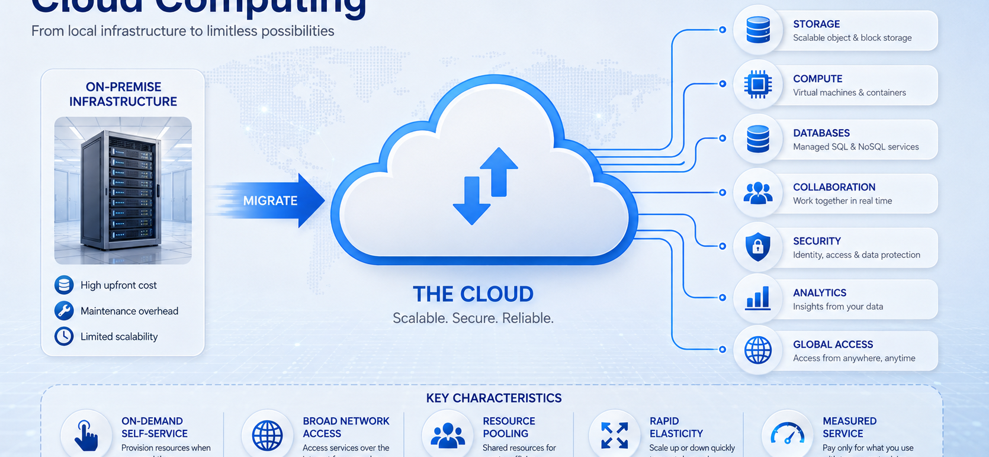
LECTURE 1
The five essential cloud characteristics
ICT411 Cloud Computing • Unit 1 • Foundations & Context
12
Notes:
Use the visual to introduce the five characteristics together: on-demand self-service, broad network access, resource pooling, rapid elasticity, and measured service. Relate each characteristic to the transition from local infrastructure to cloud services.

Slide 10
LECTURE 1
Characteristic 1: on-demand self-service
• A developer or authorised user can provision services through a web portal, command line, template, or API.
• Common actions include creating a VM, allocating storage, deploying a web app, starting a database, or enabling monitoring.
• Self-service reduces waiting time and supports rapid experimentation in development and testing.
• It must be controlled using identity, role-based access, quotas, approvals, budgets, and naming standards.
Self-service does not mean “no rules”.
It means authorised users act within approved technical and governance limits.
ICT411 Cloud Computing • Unit 1 • Foundations & Context
13
Notes:
Give an example: a student team deploying a test website quickly, but with limits so they do not create expensive resources.

Slide 11
LECTURE 1
Characteristic 2: broad network access
• Cloud services are accessed over networks using standard protocols and interfaces.
• Users may connect from laptops, smartphones, tablets, lab machines, branch offices, or backend systems.
• This supports remote work, mobile applications, collaboration platforms, and system integration.
• Design implication: performance, bandwidth, device security, authentication, and network reliability matter.
• A service can be available in the cloud but still feel unusable if the last-mile network is poor.
ICT411 Cloud Computing • Unit 1 • Foundations & Context
14
Notes:
Ask why students sometimes experience slow online platforms even when the cloud provider is not down.

Slide 12
LECTURE 1
Characteristic 3: resource pooling
Resource pooling means a provider groups compute, storage, and network capacity, then dynamically assigns those resources to many consumers.
Tenant A
student portal
Provider resource pool
servers • storage • network
Pooling improves utilisation because unused capacity from one workload can support another workload. The provider manages assignment behind the scenes.
Tenant B
clinic system
Tenant C
small business app
ICT411 Cloud Computing • Unit 1 • Foundations & Context
15
Notes:
Explain why resource pooling makes public cloud cheaper than dedicated private infrastructure for many workloads.

Slide 13
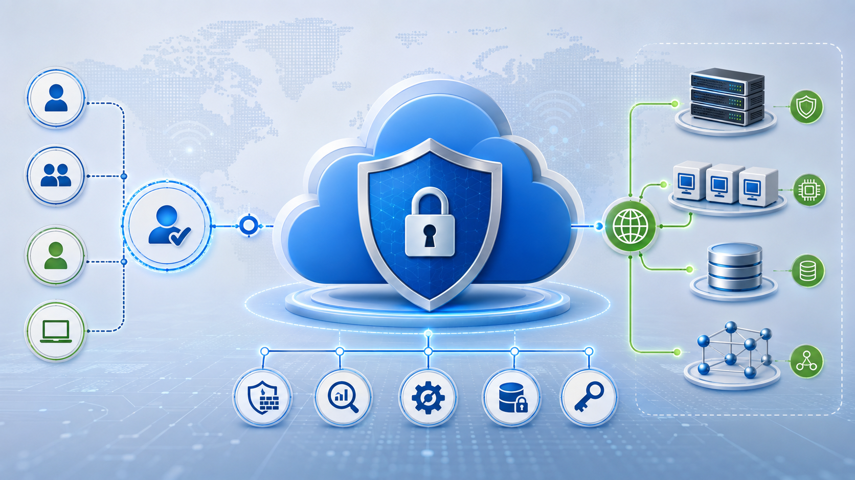
LECTURE 1
Multi-tenancy and isolation: the hidden challenge
• Multi-tenancy means multiple customers, departments, or applications share underlying provider resources.
• Sharing is efficient, but it creates a strong need for isolation between tenants.
• Isolation must protect data, memory, storage, network traffic, identities, logs, and management actions.
• A failure or misconfiguration in one tenant should not expose another tenant’s data or disrupt their service.
• This is why virtualization, access control, encryption, monitoring, and provider security practices are important.
ICT411 Cloud Computing • Unit 1 • Foundations & Context
16
Notes:
Link this to operating systems isolation, containers, virtual machines, and access control.

Slide 14
LECTURE 1
Characteristic 4: rapid elasticity
• Elasticity allows resources to expand or reduce quickly according to workload demand.
• Scaling out adds more instances; scaling up gives one instance more CPU, memory, or capacity.
• Scaling in or down removes unused resources so the organisation does not continue paying for idle capacity.
• Example: a student registration portal scales during registration week and reduces after traffic falls.
• Elasticity must be monitored because automatic scaling can also increase cost if the design is poor.
Peak demand
↑ users
↑ compute
↑ bandwidth
After peak
↓ unused resources
↓ cost
ICT411 Cloud Computing • Unit 1 • Foundations & Context
17
Notes:
Contrast elasticity with permanent expansion. Elastic cloud systems should respond to demand changes.

Slide 15
LECTURE 1
Characteristic 5: measured service
• Cloud platforms measure usage such as CPU time, storage space, network transfer, database operations, API requests, and active users.
• Measurement supports billing, budgeting, capacity planning, performance analysis, and governance.
• Students should learn that easy deployment can become expensive when monitoring and budgets are ignored.
• A good cloud engineer watches both technical health and cost health.
• Professional habit: tag resources, set alerts, review usage, and remove unused resources.
Usage → Monitoring → Reports → Cost control → Better decisions
Always ask: “What will this consume, and how will we know?”
ICT411 Cloud Computing • Unit 1 • Foundations & Context
18
Notes:
Introduce cost thinking without making the lecture financial. Metered services require disciplined design.

Slide 16
LECTURE 1
Global nature of cloud services
• Cloud providers operate data centers in different regions and availability zones around the world.
• Applications can be placed closer to users to reduce latency and improve user experience.
• Global reach supports collaboration across campuses, branches, countries, and mobile users.
• Data location affects compliance, privacy, performance, backup, and disaster recovery choices.
• Good design asks: where are my users, where is my data, and what laws or policies apply?
ICT411 Cloud Computing • Unit 1 • Foundations & Context
19
Notes:
Use data sovereignty and latency as the two core points. Region selection is both technical and legal.

Slide 17
LECTURE 1
Reliability, availability, and fault tolerance
• Reliability asks whether the system performs correctly over time.
• Availability asks whether users can reach the system when they need it.
• Fault tolerance means the system continues working even when some components fail.
• Cloud architecture uses redundancy, health checks, load balancing, backups, monitoring, and automated recovery.
• No cloud design is failure-proof; good design limits the damage and recovery time.
Example
A cloud web app may use multiple web servers and database replicas so one failed server does not stop all users.
Design for failure before failure happens.
ICT411 Cloud Computing • Unit 1 • Foundations & Context
20
Notes:
Clarify that cloud does not automatically guarantee high availability; architecture choices matter.

Slide 18
LECTURE 1
Benefit 1: cost savings and financial flexibility
• Cloud can reduce upfront capital spending because organisations do not need to buy all infrastructure before use.
• Pay-as-you-use models help teams match spending to actual consumption.
• Managed services reduce some maintenance tasks such as hardware replacement and basic platform operations.
• Cost savings are not automatic: idle resources, over-provisioning, poor architecture, and uncontrolled data transfer can increase bills.
• A professional cloud decision includes budget alerts, usage reviews, and resource lifecycle management.
ICT411 Cloud Computing • Unit 1 • Foundations & Context
21
Notes:
This expands the cost savings point from the lecture notes and adds balanced judgement.

Slide 19
LECTURE 1
Benefit 2: scalability, flexibility, and collaboration
• Scalability allows systems to serve more users, store more data, or process more work as demand grows.
• Flexibility allows staff and students to access applications and data from different places and devices.
• Collaboration services allow teams to share documents, repositories, dashboards, communication tools, and development environments.
• For developers, cloud platforms make it easier to create test environments, automate deployments, and integrate services.
• The same benefits support e-learning, research collaboration, banking applications, mobile services, and analytics projects.
ICT411 Cloud Computing • Unit 1 • Foundations & Context
22
Notes:
Connect benefits to student life and industry practice.

Slide 20
LECTURE 1
Challenge 1: availability of service
• Availability risk asks what happens when the provider, network connection, DNS, identity service, payment service, or user device fails.
• A cloud service may be hosted in a strong data center but still be inaccessible to users with weak connectivity.
• Organisations must define acceptable downtime, recovery time, and recovery point objectives.
• Important controls include monitoring, alerts, backups, multi-zone deployment, failover plans, and offline procedures where necessary.
• Students should ask: what must continue working even when the cloud or internet path is unavailable?
ICT411 Cloud Computing • Unit 1 • Foundations & Context
23
Notes:
This elaborates the availability challenge from the attached notes. Use examples such as exams, banking, hospital records, and payroll.

Slide 21
LECTURE 1
Challenge 2: vendor lock-in and limited mobility
• Vendor lock-in occurs when a system becomes difficult or expensive to move away from one cloud provider.
• Lock-in can come from proprietary APIs, data formats, specialised services, identity integrations, training, contracts, and operational habits.
• Moving large datasets or reconfiguring applications may require downtime, redesign, or additional cost.
• Mitigation includes standards-based interfaces, clear documentation, portable architecture where practical, backup exports, and exit planning.
• Lock-in is not always bad, but it must be a conscious decision rather than an accidental dependency.
Design question
How hard would it be to leave this provider in one year?
Exit planning is part of good architecture.
ICT411 Cloud Computing • Unit 1 • Foundations & Context
24
Notes:
Explain that portability is a trade-off; using advanced provider services can bring benefits but may reduce mobility.

Slide 22
LECTURE 1
Challenge 3: data transfer bottlenecks
• Many modern applications are data-intensive: analytics, AI, backups, video, images, sensor data, logs, and large databases.
• Moving large data volumes can be slow, expensive, or unreliable depending on bandwidth, distance, provider charges, and data design.
• Data movement affects user experience, backup windows, analytics processing, and migration planning.
• Design responses include data compression, caching, regional placement, incremental sync, content delivery, and moving computation closer to data.
• Before migration, estimate the data size, transfer speed, cost, and acceptable downtime.
ICT411 Cloud Computing • Unit 1 • Foundations & Context
25
Notes:
Use a simple question: how long would it take to upload terabytes of data over an unreliable connection?

Slide 23
LECTURE 1
Challenge 4: security and confidentiality
• Cloud data may be stored, processed, backed up, and transmitted through systems the consumer does not physically control.
• Security controls include identity management, least privilege, access reviews, encryption, logging, backups, patching, and incident response.
• Confidentiality is especially important for sensitive systems such as healthcare, financial services, student records, and government data.
• Responsibility differs by service model: SaaS, PaaS, and IaaS place different duties on the provider and consumer.
• Trust must be supported by contracts, audits, monitoring, policy, and technical controls.
ICT411 Cloud Computing • Unit 1 • Foundations & Context
26
Notes:
This expands security and confidentiality concerns in the attached notes. Reinforce the shared responsibility idea.

Slide 24
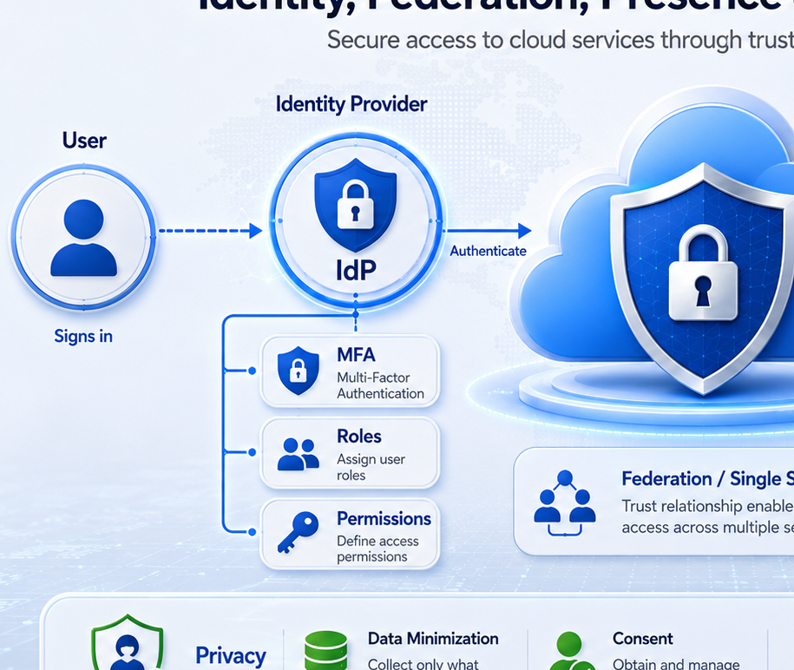
LECTURE 1
Legal, policy, and privacy issues
• Cloud data may be stored or processed in different countries, so organisations must understand data-location and jurisdiction requirements.
• Privacy requires clear purpose, data minimization, appropriate consent, access control, retention rules, and secure disposal.
• Identity and federation simplify access across services, but weak authentication or excessive privileges can expose many systems at once.
• Contracts should define responsibilities for security, incident reporting, availability, backup, audit, and data return when the service ends.
• Computer scientists must translate policy requirements into technical controls and evidence.
ICT411 Cloud Computing • Unit 1 • Foundations & Context
27
Notes:
Use the identity/federation visual to show how privacy and access controls work together. Emphasize that cloud decisions involve legal and organisational responsibility, not only technology.

Slide 25
LECTURE 1
Cloud vulnerabilities and outage thinking
• Cloud environments can be affected by malicious attacks, software defects, human error, misconfigurations, power failures, and network failures.
• A single dependency such as DNS, identity, storage, messaging, or payment can become a point of failure.
• Denial-of-service attacks can overwhelm services if protection, scaling, and filtering are weak.
• Physical events such as power incidents or regional disruptions show why disaster recovery planning matters.
• Good architects assume failure is possible and design detection, response, communication, and recovery early.
ICT411 Cloud Computing • Unit 1 • Foundations & Context
28
Notes:
This slide expands the vulnerability examples from the lecture notes while keeping focus on design thinking, not memorisation.

Slide 26
LECTURE 1
Common cloud use cases
• Data storage and backup: protect files, databases, logs, and application data.
• Software development and testing: create repeatable development, test, and staging environments.
• Web and mobile applications: host services for users across many locations and devices.
• Big data analytics: process and analyse large datasets using scalable compute and storage.
• Disaster recovery: restore systems after hardware failure, cyberattack, power loss, or site disruption.
• Collaboration: enable shared documents, video meetings, messaging, and team productivity tools.
ICT411 Cloud Computing • Unit 1 • Foundations & Context
29
Notes:
Ask students to classify examples from real institutions under these use cases.

Slide 27
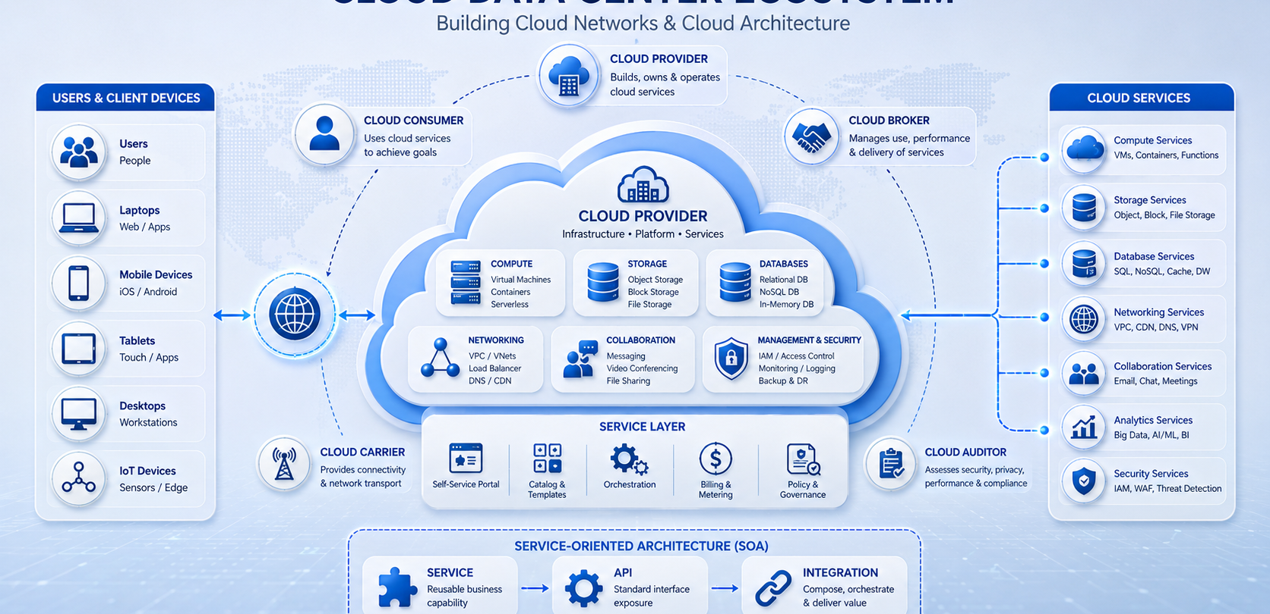
LECTURE 1
Cloud architecture: what does the term mean?
ICT411 Cloud Computing • Unit 1 • Foundations & Context
30
Notes:
Walk through the visual from users and devices to networking, provider infrastructure, compute, storage, databases, security, monitoring, and service layers. Explain that architecture documents both technical components and the relationships among them.

Slide 28
LECTURE 1
NIST cloud architecture actors
• Cloud consumer: person or organisation that uses cloud services.
• Cloud provider: organisation that offers and operates cloud services.
• Cloud carrier: intermediary that provides connectivity and transport between consumer and provider.
• Cloud broker: manages use, performance, delivery, or negotiation between consumer and provider.
• Cloud auditor: independently evaluates performance, security, and operations.
Remember: cloud architecture includes technical systems and organisational roles.
ICT411 Cloud Computing • Unit 1 • Foundations & Context
31
Notes:
This follows the actor descriptions in the attached lecture notes. Give a local example for each role.

Slide 29
LECTURE 1
How the cloud actors interact
Consumer
requests service
Carrier
connectivity
Provider
delivers service
Auditor
checks controls
Broker may help select, manage, integrate, or negotiate services between consumer and provider.
• The model helps students see cloud as an ecosystem, not only a data center.
• When a service fails, responsibility may involve more than one actor.
ICT411 Cloud Computing • Unit 1 • Foundations & Context
32
Notes:
Explain that problems often cross actor boundaries: provider outage, carrier network issue, consumer misconfiguration, or broker integration failure.

Slide 30
LECTURE 1
Best practice 1: upfront planning
• Before deploying, identify users, workload patterns, data sensitivity, availability needs, performance targets, and budget limits.
• Estimate peak and normal demand so the architecture can scale without uncontrolled spending.
• Plan environments such as development, testing, staging, and production instead of mixing everything together.
• Define ownership: who creates resources, who approves changes, who monitors alerts, and who responds to incidents?
• Planning reduces unexpected production problems and improves communication among technical and management teams.
ICT411 Cloud Computing • Unit 1 • Foundations & Context
33
Notes:
This elaborates the upfront planning best practice from the attached notes.

Slide 31
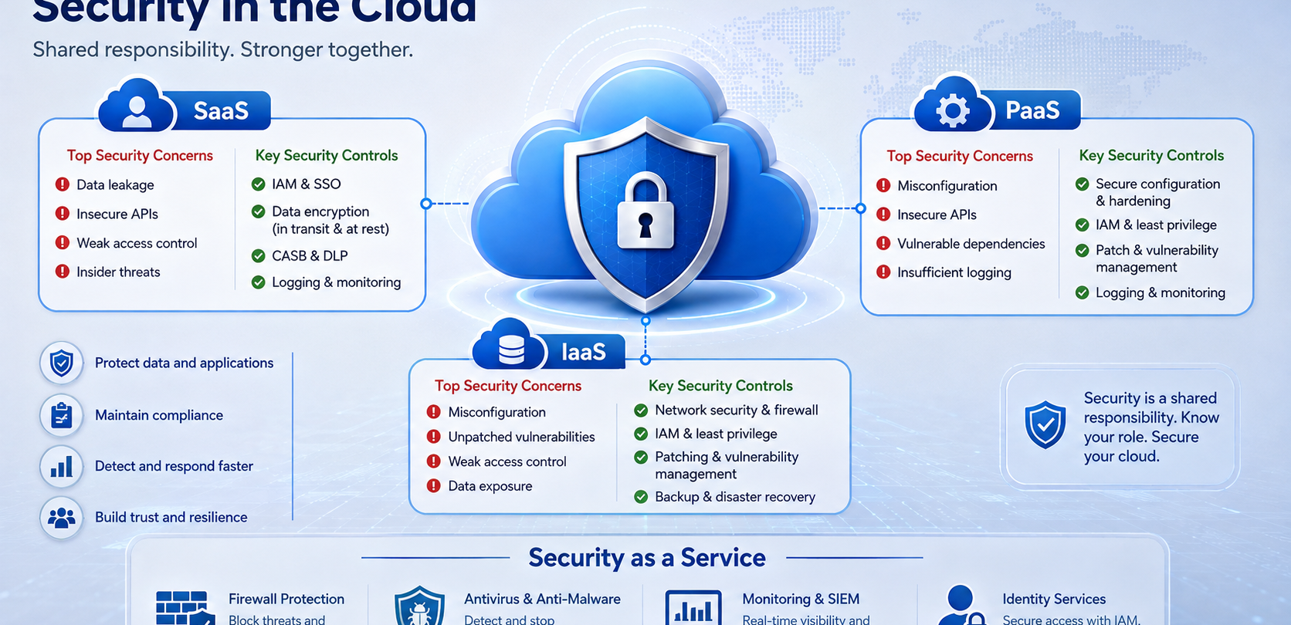
LECTURE 1
Best practice 2: security first
ICT411 Cloud Computing • Unit 1 • Foundations & Context
34
Notes:
Use the visual to explain shared responsibility across SaaS, PaaS, and IaaS. Reinforce practical controls: IAM and SSO, least privilege, encryption, secure configuration, patching, vulnerability management, logging, monitoring, backup, and disaster recovery.

Slide 32
LECTURE 1
Best practice 3: disaster recovery readiness
• Disaster recovery is the ability to restore service after a major disruption.
• Backups must be automated, protected, tested, and stored in a way that supports recovery.
• Recovery Time Objective asks how quickly service must be restored.
• Recovery Point Objective asks how much data loss is acceptable.
• Plans should include people, communication, technical steps, supplier contacts, and evidence from recovery tests.
RTO
How long can we be down?
RPO
How much data can we lose?
Untested backup = uncertain recovery
ICT411 Cloud Computing • Unit 1 • Foundations & Context
35
Notes:
Teach RTO and RPO as practical vocabulary students can apply immediately.

Slide 33
LECTURE 1
Best practice 4: performance and cost optimization
• Performance optimization uses monitoring data to find slow services, overloaded resources, poor database queries, and network delays.
• Cost optimization removes waste through rightsizing, scheduling, storage lifecycle rules, tagging, and budget alerts.
• Cloud teams must review resources regularly because unused systems continue consuming money.
• Performance and cost must be balanced: the cheapest design may be slow, while the fastest design may be too expensive.
• A professional recommendation should include evidence from metrics, not only assumptions.
ICT411 Cloud Computing • Unit 1 • Foundations & Context
36
Notes:
This elaborates cost optimization and performance best practices from the attached notes.

Slide 34
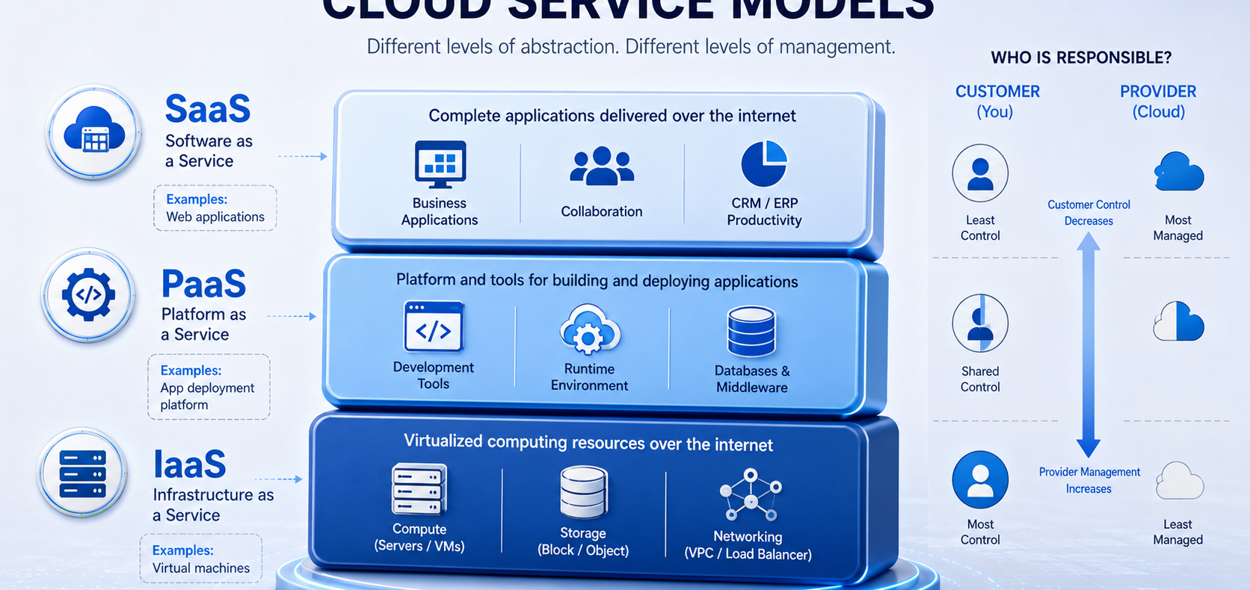
LECTURE 1
Preview: cloud service models
ICT411 Cloud Computing • Unit 1 • Foundations & Context
37
Notes:
Use this visual as a preview only. Show that SaaS offers complete applications, PaaS provides managed application platforms, and IaaS provides virtualized compute, storage, and networking. Detailed responsibility boundaries are covered in Unit 2.

Slide 35
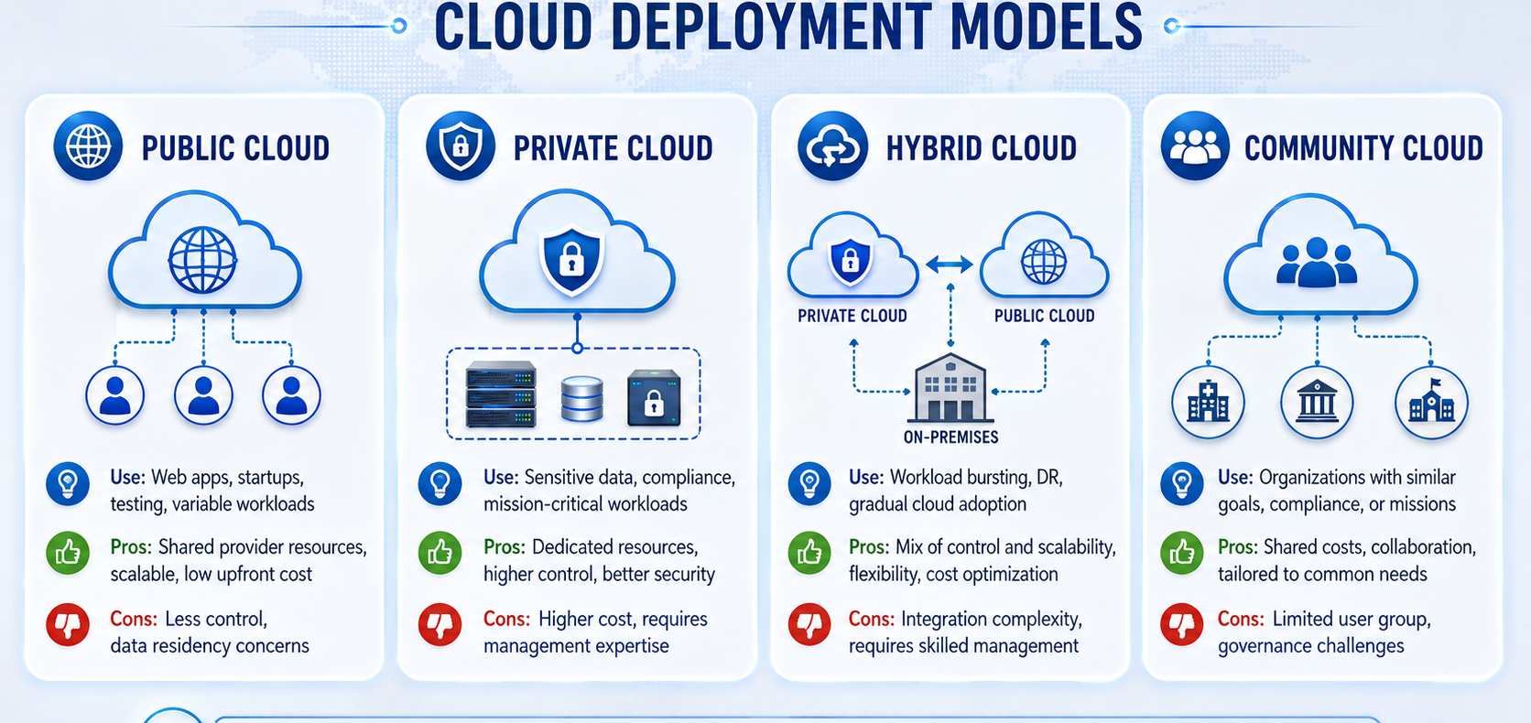
LECTURE 1
Preview: cloud deployment models
ICT411 Cloud Computing • Unit 1 • Foundations & Context
38
Notes:
Use the visual to preview public, private, hybrid, and community cloud. Stress that the selection depends on control, cost, security, compliance, scalability, and management capability.

Slide 36
LECTURE 1
Unit summary and exit ticket
• Cloud computing delivers computing services over the internet without requiring consumers to own all local infrastructure.
• Its foundations include distributed systems, grid computing, virtualization, automation, data centers, APIs, and internet software evolution.
• The five essential characteristics are on-demand self-service, broad network access, resource pooling, rapid elasticity, and measured service.
• Benefits include cost flexibility, scalability, collaboration, reliability, and faster delivery; risks include outages, lock-in, data bottlenecks, legal issues, and security concerns.
• Exit ticket: explain one cloud benefit, one cloud risk, and one control that reduces that risk.
Next unit: Cloud Service and Deployment Models
ICT411 Cloud Computing • Unit 1 • Foundations & Context
40
Notes:
End by asking two students to share their exit-ticket answer verbally.

